Slide 1
New Forms: Secure Messaging in Connect
2024 Portal Enhancements

Slide 2
Log-in to Connect with your secure username and password

Slide 3
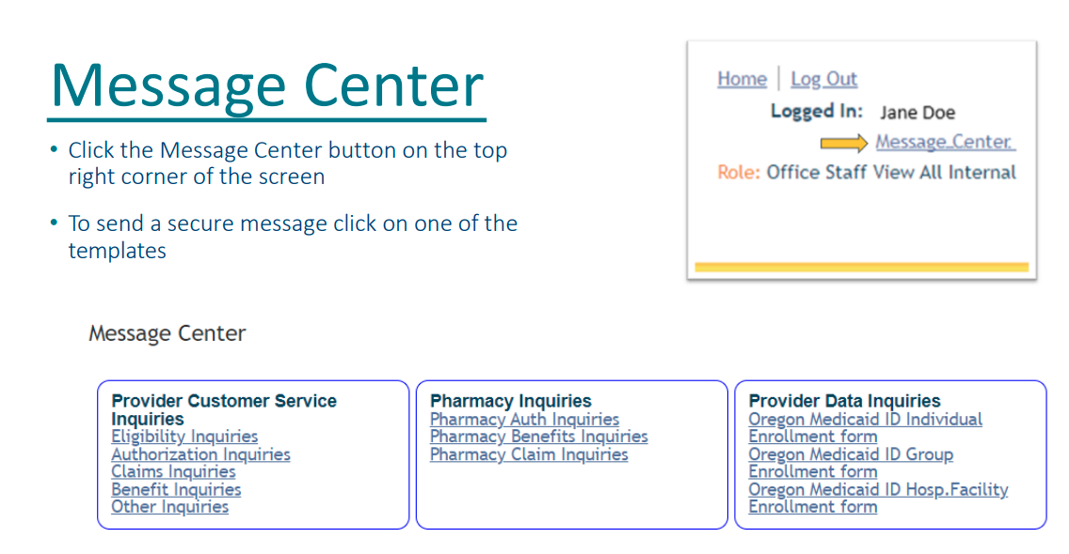

Slide 4
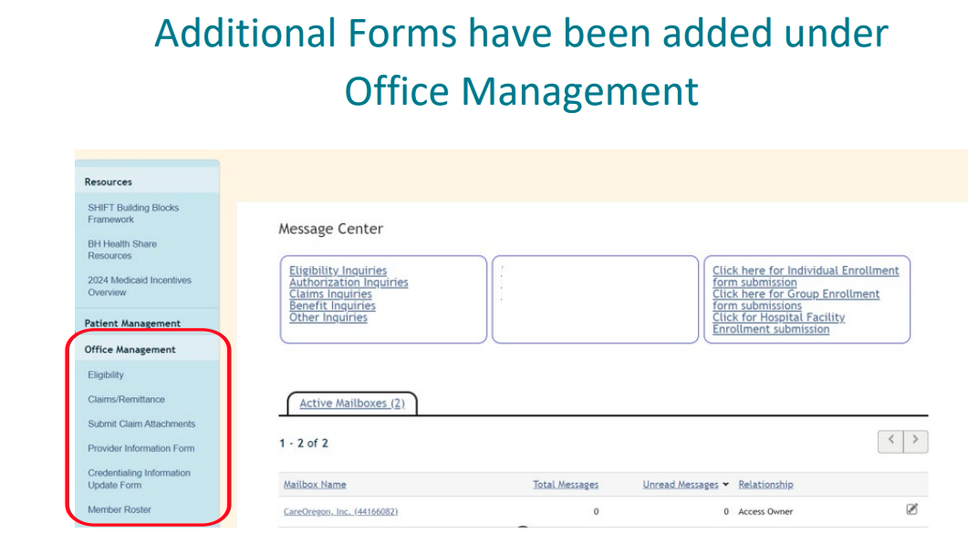

Slide 5
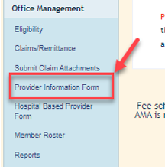
Provider Information Form (PIF)
This 2024 portal enhancement offers our provider network a secure form submission option when adding or changing provider/practice information.
Providers can now submit the Provider Information Form (PIF) securely through the portal.
The secure PIF indicates which data fields are required to support accuracy in data used for provider payment, the Provider Directory, and network adequacy.
Multiple practice locations can be added in one submission.

Slide 6
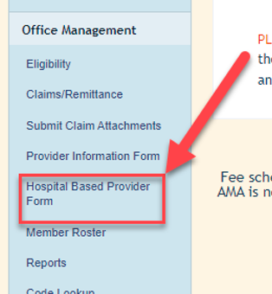
Hospital-Based Provider Form
Provider/practice affiliation is solely hospital-based or downstream
This 2024 portal enhancement offers our provider network a secure form submission option when adding or changing hospital-based provider/practice information.
Providers can now submit the Hospital Based Provider Form securely through the portal.
The secure form indicates which data fields are required to support accuracy in the data used for provider payment, the Provider Directory, and network adequacy.
Important Note: This form is not to be used if the provider/practice is not solely hospital-based or downstream. Instead, complete an Oregon Practitioner Credentialing Application (OPCA) available on the Oregon health Authority’s website.

Slide 7
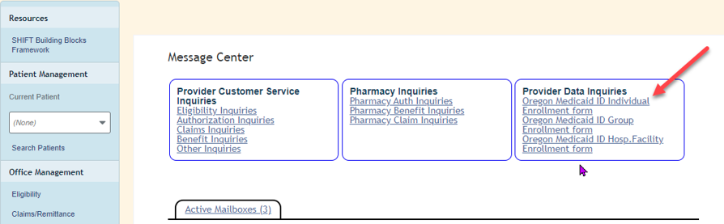
DMAP Enrollment Smart Form
Oregon Division of Medical Assistance (DMAP) enrollment
This 2024 portal enhancement offers our provider network a secure form submission option when requesting support to enroll a provider (Type 1) or organization/facility (Type 2) in Oregon Medicaid to bill CCOs for services.
By completing the Medicaid Enrollment form via the Provider Portal, our Provider Data team will submit the information directly to the Oregon Health Authority (OHA) for processing/approval on the provider’s behalf.
Important Note: Once the application is approved by the OHA, the provider/organization will be enrolled as an “Encounter-Only” Oregon Medicaid Provider which means they may submit claims to CCOs only. If a provider wants to bill Open-Card they will need to submit an application directly to the Oregon Health Authority.

Slide 8
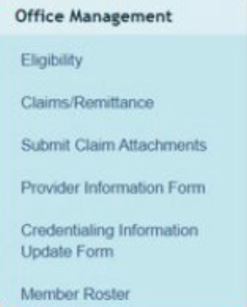
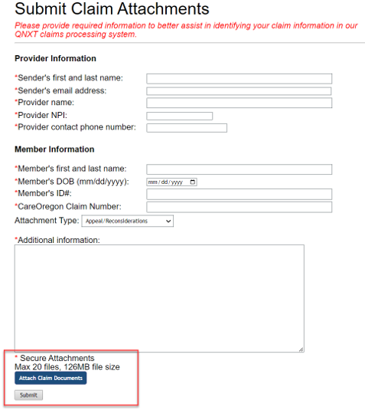
Submitting Claims Attachments
This 2024 portal enhancement offers our provider network an opportunity to submit required claims-related information & documentation directly to the Claims department.
Step 1: Click
Step 2: Attach
Step 3: Submit

Slide 9
Types of Claims Attachments
The following are available attachment types:
Appeals/Reconsiderations – Information related to request for review of claims that have already been finalized with medically related denials.
EOB/Remits/MVA/Liability – Information needed to coordinate benefits with member’s primary/external coverage plans
Itemized Bill for Hospital Stays – Information related to Itemized Hospital bills related to review of Hospital Standardized billing form (UB) information
Sterilized Consent Forms – Documents related to Oregon Health Plans Sterilization Consent Form process
Retro Authorizations – Information related to requests to review previously denied claims for no authorization for potential post service approval
Prolonged Services Review – Information related to our Prolonged Services review process
Medical Records – When Medical Records are requested for a claim review but do not fit the above form types
Other – For information that does not fit in any of the above categories.

Slide 10
Thank you

